Slide 1
IMPROVING THE COMPETENCIES OF RESEARCH LIBRARIANS THROUGH WEBINAR IN THE COVID-19 PANDEMIC ERA
Noeraida, Rochani Nani Rahayu, Anggiana Rohandi Yusuf
Librarian
Email: noerda@batan.go.id
Disampaikan pada:
International Conference On Library And Information Science 2021
Selasa / 7 September 2021

Slide 2
Scope of Presentation
Introduction
Librarian competency
Webinar
Previous research
Purposes and method research
Results and discussion
Conclusion

Slide 3
Introduction
Early March: the first two cases of positive Covid-19 patients in Indonesia
SE Minister of PANRB Number 19/2020, and
Number 54/2020, working from home (WFH) until now.
The Regulation of LAN RI Number 10/2018, Development of the competence: ASN must achieve the fulfilment of 20 hours per year.
One method to increase competence during a pandemic like today is by participating in webinars

Slide 4
Librarian Competency
Competence is a set of knowledge, skills and behaviors that must be possessed, internalized and mastered by librarians in carrying out their duties professionally

Slide 5
Canadian Assocation of Research Libraries (CARL) 7 (seven) core competencies for research librarians
(1) Having basic knowledge
(6) Research and contribution to the profession
(7) Skills in using information technology
(2) Interpersonal competence
(3) Leadership and management
(4) Collection development
(5) Information literacy

Slide 6
Webinar
Webinars are seminars, presentations, teaching or workshops that are conducted face-to-face online and delivered via the internet, attended by participants remotely and in different locations

Slide 7
Benefits of webinars Silvianita & Yulianto (2020)
(1) cost-effective because it does not require travel costs
(6) can interact directly with speaker
(7) can increase knowledge and experience in the learning process
(2) easier registration and administration process
(3) can be followed by many participants
(4) can be recorded
(5) can see the material directly in the form of images, videos, or information via chat or quick and answer
(8) can improve competence

Slide 8
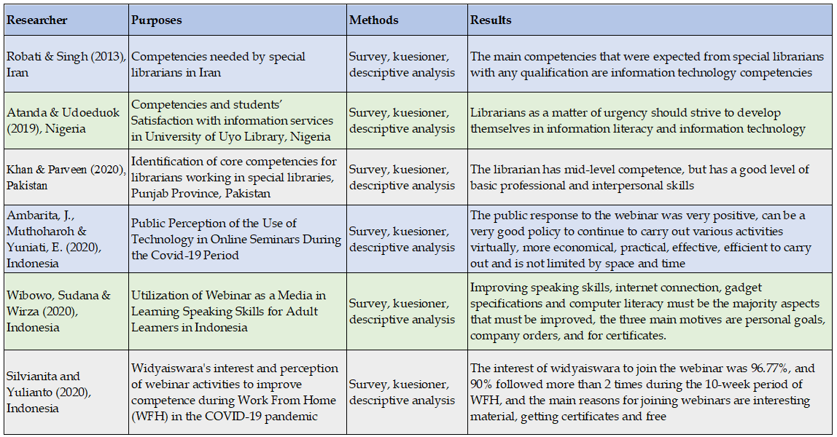
Previous research

Slide 9
PURPOSES RESEARCH
(1) Types of activities carried out by librarians during WFH
(6) Useful material according to the librarians
(7) Obstacles encountered when participating in the webinar
(2) The frequency of librarians attending training during the 2017-2019 period.
(3) The frequency of librarians attending seminars during the 2017-2019 period
(4) Frequency of librarians participating in webinars during 2020
(5) Webinar material that is preferred by librarians

Slide 10
Research Method
Held from April to May 2021,
Descriptive method, with a quantitative approach
Population: librarians
Scope: LPNK Ristek: LIPI, BATAN, BSN, BAPETEN, BPPT and LAPAN
The sampling technique used is simple random sampling
Data collection techniques used a questionnaire
Adopted from the research of Silvianita & Yulianto (2020), then developed and adapted to the competence of the library
Dissemination of online questionnaires via Google Forms, sent via email and WhatsApp number on 17 – 25 April 2021
Data analysis uses pivot tables from Microsoft Excel 2010 to get the data into tables and charts, and then discusses and draws conclusions from the research results.

Slide 11
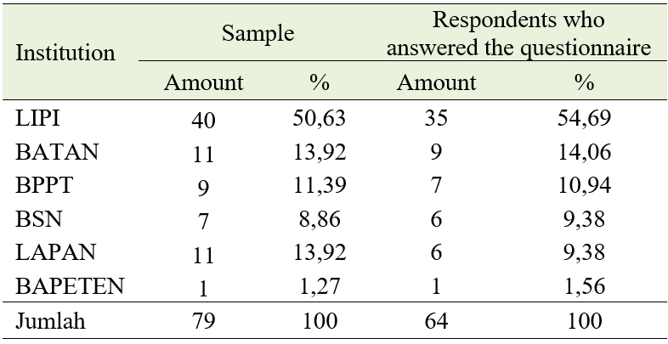
RESULTS AND DISCUSSION
Respondent Distribution

Slide 12
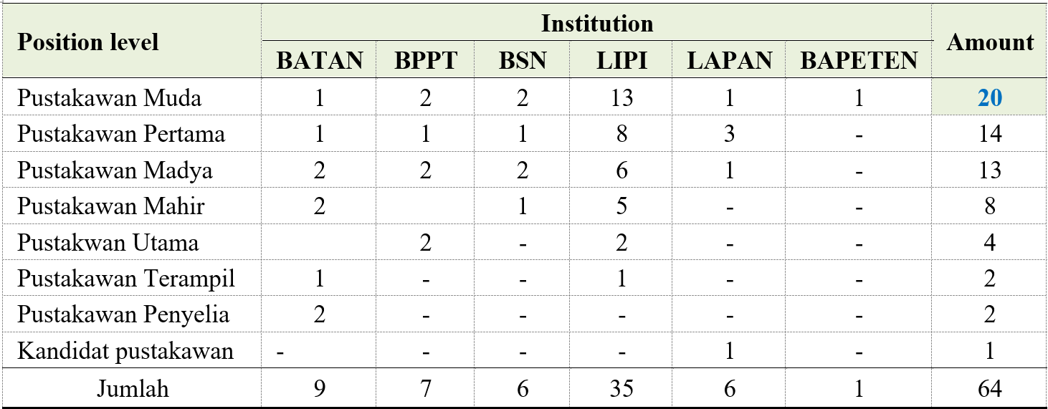
RESULTS AND DISCUSSION
Respondent's position

Slide 13
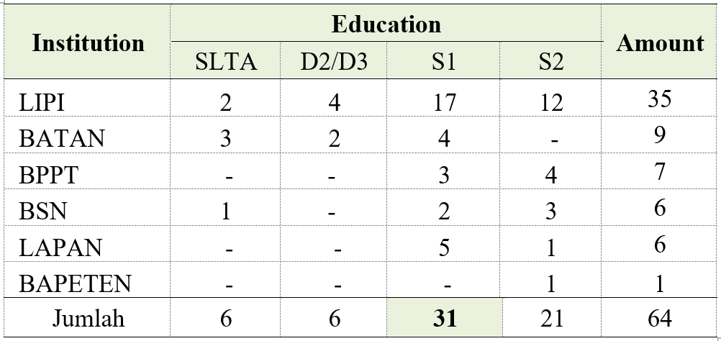
RESULTS AND DISCUSSION
Respondent's education

Slide 14
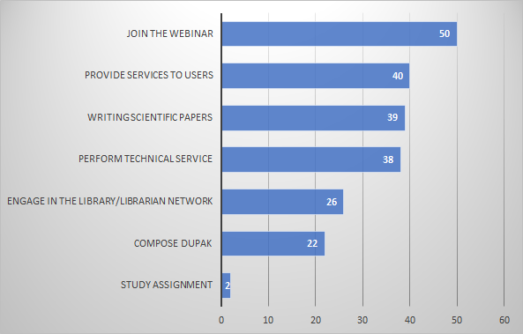
RESULTS AND DISCUSSION
Librarian activities while work from home

Slide 15
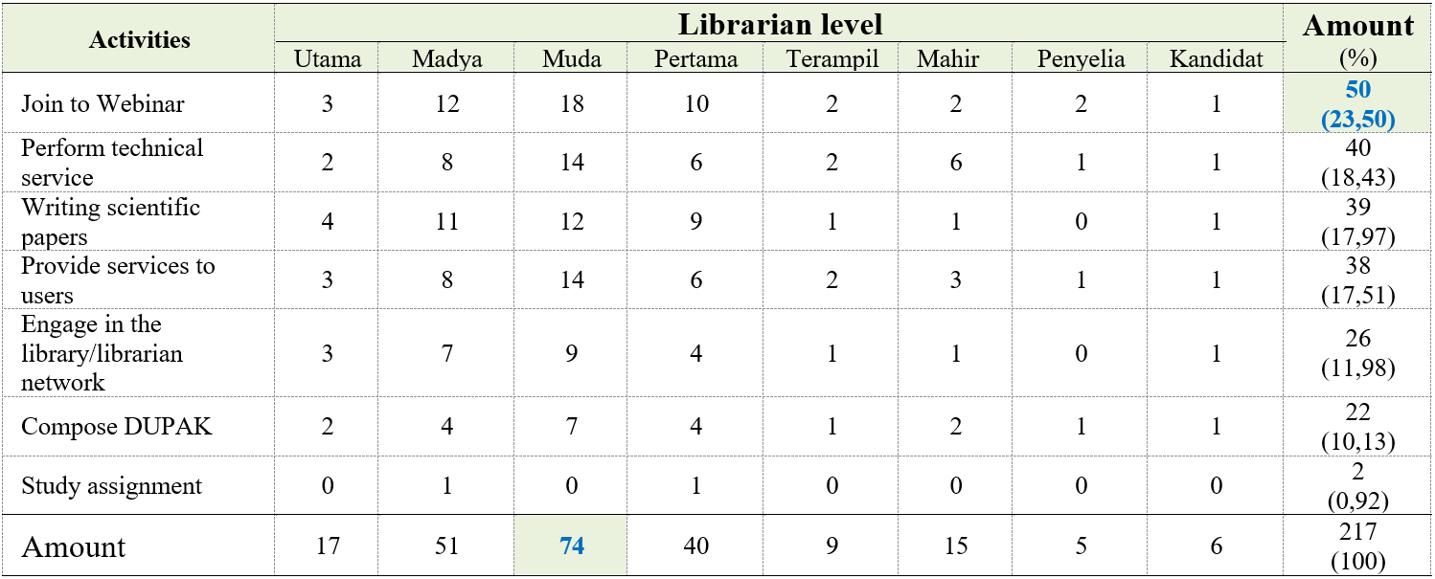
RESULTS AND DISCUSSION
Librarian activities while WFH

Slide 16
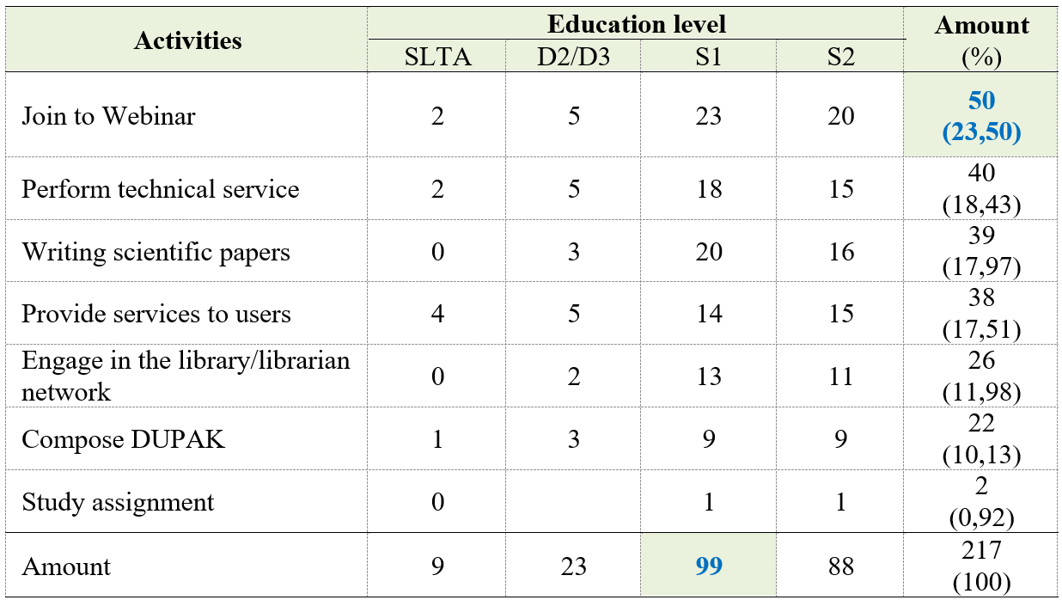
RESULTS AND DISCUSSION
Librarian activities while WFH

Slide 17
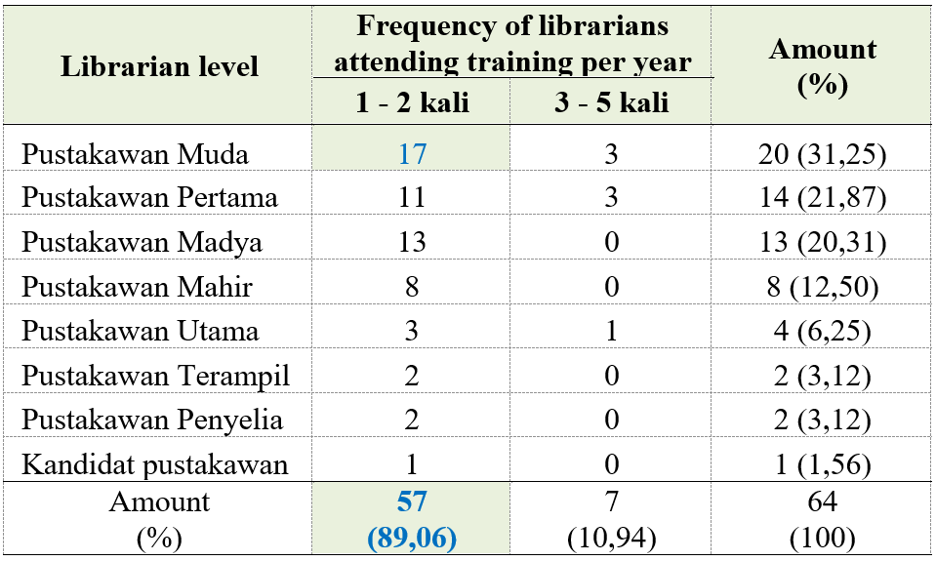
RESULTS AND DISCUSSION
Frequency of librarians attending training per year during the period 2017-2019

Slide 18
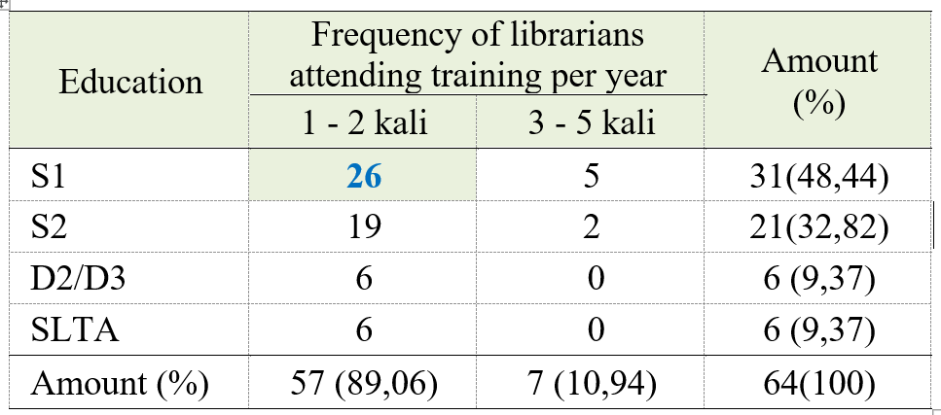
RESULTS AND DISCUSSION
Frequency of librarians attending training per year during the period 2017-2019

Slide 19
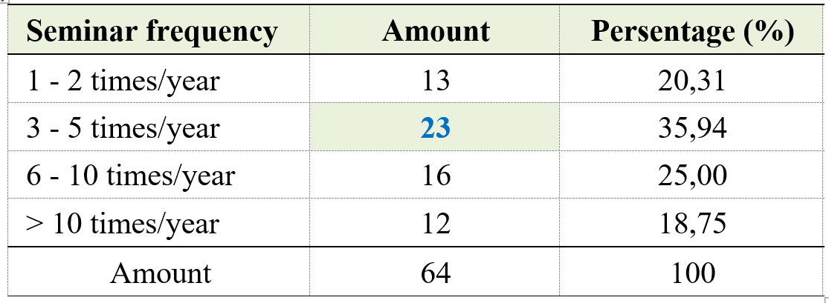
RESULTS AND DISCUSSION
Frequency of librarians attending seminar per year during the period 2017-2019

Slide 20
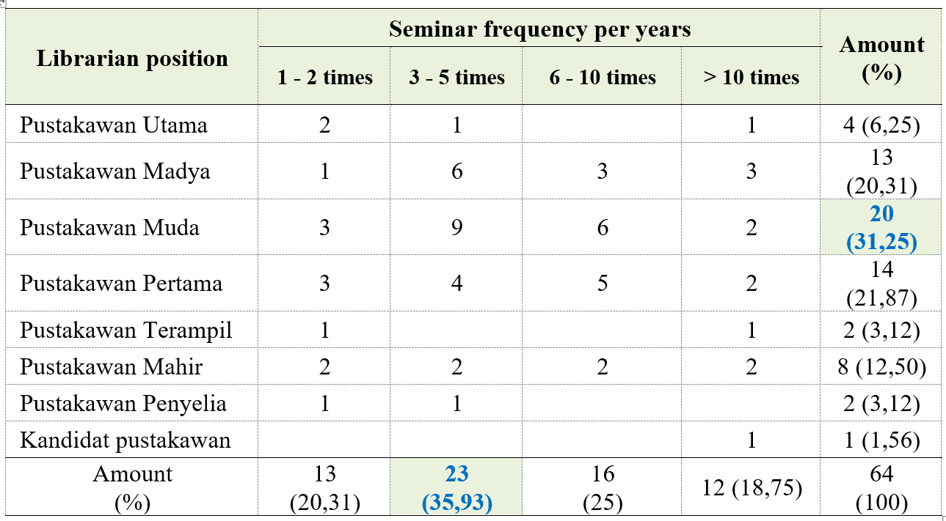
RESULTS AND DISCUSSION
Frequency of librarians attending seminar per year during the period 2017-2019

Slide 21
RESULTS AND DISCUSSION
Frequency of librarians attending seminar per year during the period 2017-2019

Slide 22
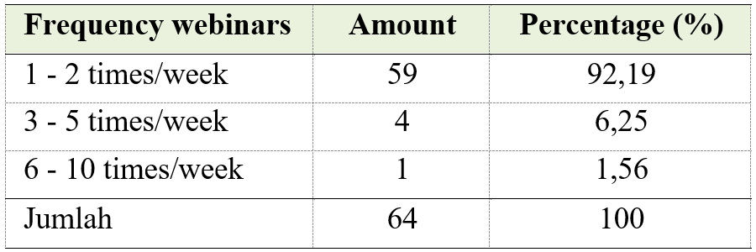
RESULTS AND DISCUSSION
Frequency of attending weekly webinars in 2020

Slide 23
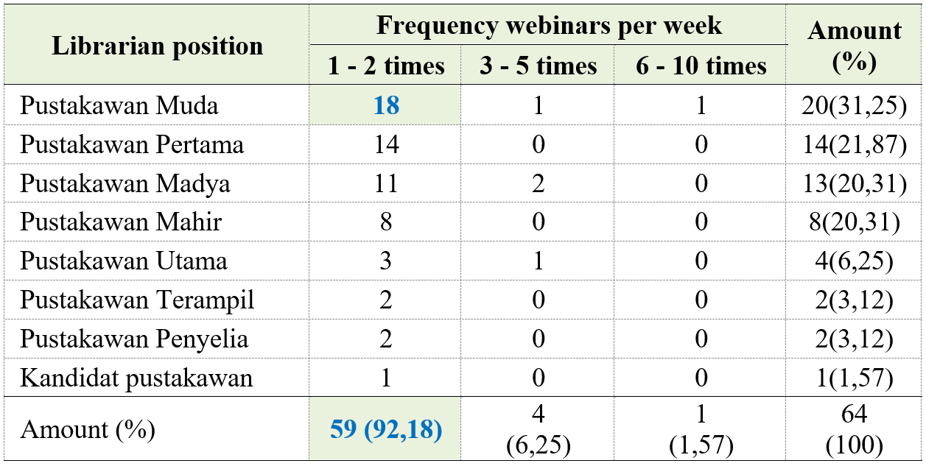
RESULTS AND DISCUSSION
Frequency of attending weekly webinars in 2020

Slide 24
RESULTS AND DISCUSSION
Frequency of attending weekly webinars in 2020

Slide 25
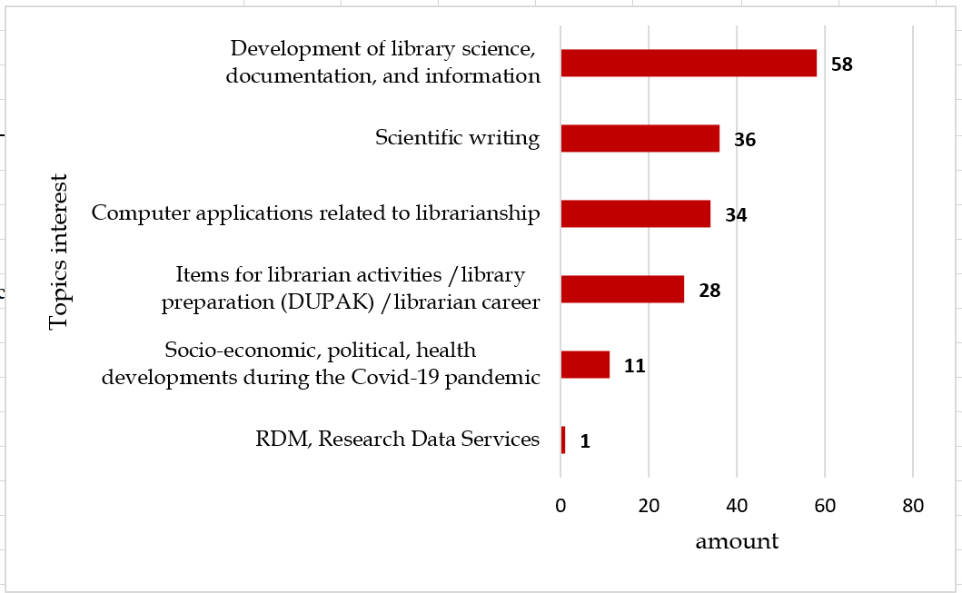
RESULTS AND DISCUSSION
The material/topics most interested by librarians

Slide 26
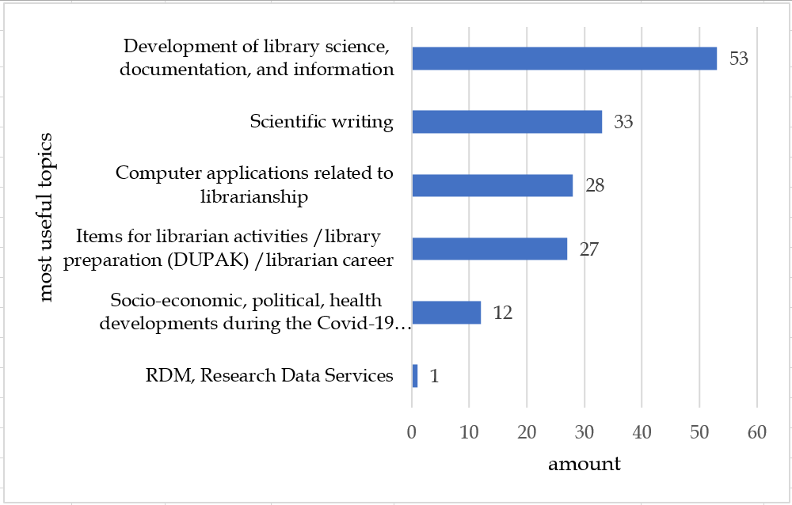
RESULTS AND DISCUSSION
The material/topics most useful by librarians

Slide 27
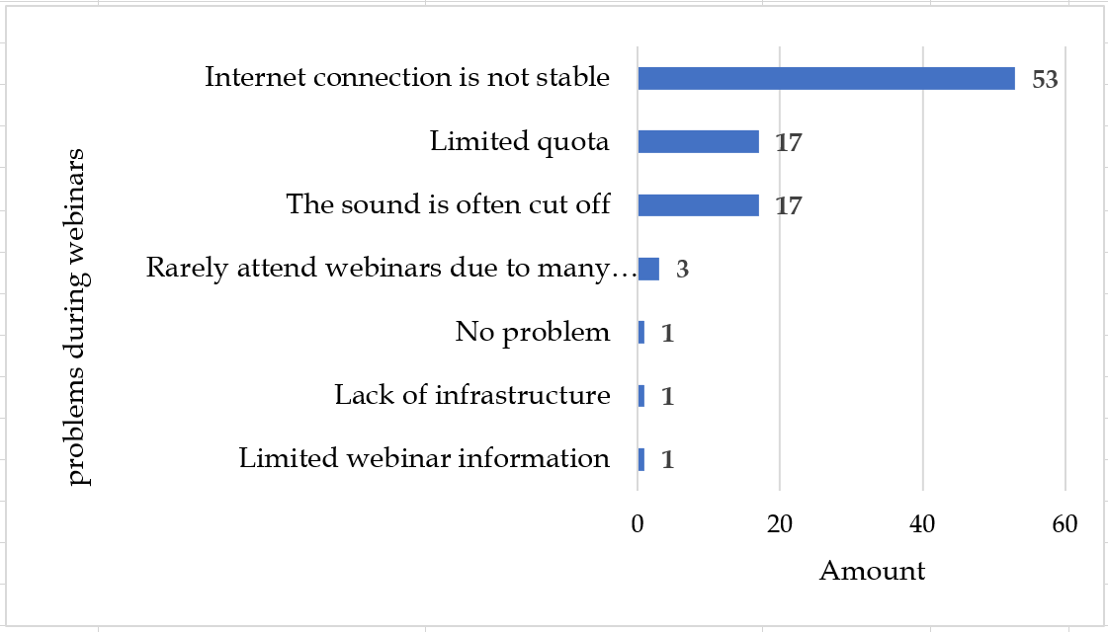
RESULTS AND DISCUSSION
Obstacles when participating in webinars

Slide 28
CONCLUSION
Even during the Covid-19 pandemic, research librarians at LPNK RISTEK continue to work and learn to improve competence by participating in webinar.
Webinars are much more attended by librarians than off-line seminars and training.
According to librarians, the most interesting and useful topics are the development of library science, documentation and information
The topic of less interest is about Research Data Management or
Research Data Services.
It is necessary to research why librarians are less interested in participating in webinars on Research Data Management or Research Data Services.

Slide 29
THANK YOU
BADAN TENAGA NUKLIR NASIONAL
Jl. Kuningan Barat, Mampang Prapatan Jakarta, 12710
(021) 525 1109 | Fax. (021) 525 1110
humas@batan.go.id
Humas Batan
@humasbatan
badan_tenaga_nuklir_nasional
Humas Batan

Slide 30
Jl. Kuningan Barat, Mampang Prapatan Jakarta, 12710
(021) 525 1109 | Fax. (021) 525 1110
humas@batan.go.id
contact us
@humasbatan
Humas Batan
badan_tenaga_nuklir_nasional
Humas Batan

